Slide 1


M.Tech Program
Advanced Industry Integrated Programs
Jointly offered by University and LTIMindTree
AI-Powered Flight Delay Predictor & Analyzer
Hetvi Bhora
TID : T8576
Knowledge partner | Implementation partner

Slide 2
Project Title - Calibri body 18
Introduction
Flight delays are a major operational and customer satisfaction issue in the aviation industry.
This project aims to predict average flight delays for specific carriers, airports, and months.
It uses a combination of forecasting algorithms and machine learning models to analyze historical and operational data.
A Large Language Model (LLM) is integrated to generate natural language explanations of the predictions.
Designed to support airlines, airports, and travel platforms in making data-driven decisions.

Slide 3
Project Title - Calibri body 18
Objectives
Data Collection using APIs, Scraping etc..
Predict average flight delay for a given carrier, airport, and month.
Break down delay causes into categories: Carrier, Weather, NAS (National Airspace System), and Late Aircraft.
Generate human-readable explanations using LLMs to support decision-making.
Provide an interactive UI for users to input parameters and view predictions.
Enable future scalability to real-time predictions and broader airport coverage.

Slide 4
Project Title - Calibri body 18
Scope ( Project flow )
Project Setup & Data Collection
Data Cleaning & preprocessing
Exploratory Data Analysis
Forecasting Model Development
Delay Attribution Model
LLM Integration & Explanation Generation
Evaluation & refinement
User Interface
Deployment

Slide 5
Project Title - Calibri body 18
Literature Review
Paper 1: Integrating multiple data sources for improved flight delay prediction using explainable machine learning ( ScienceDirect )
Abstract- The paper proposes a methodology that integrates multiple data sources to improve flight delay prediction using explainable artificial intelligence (xAI). It focuses on identifying key features that influence delays and making the prediction process transparent and interpretable.
Paper 2: Dynamically forecasting airline departure delay probability distributions for individual flights using supervised learning ( ScienceDirect )
Abstract- The paper introduces a dynamic and probabilistic approach to forecasting departure delays for individual flights, using supervised learning. The goal is to improve operational efficiency, especially in hub-and-spoke airlines, by enabling better fuel planning and delay management.

Slide 6
Project Title - Calibri body 18
Industry Resources
FlightAware – Real-time flight tracking and predictive analytics
Airbus Skywise – Aviation data platform with predictive maintenance and delay analytics
GE Aviation – Fuel and delay optimization tools
Cirium – Flight delay prediction and analytics
Lumo – Predictive flight delay alerts for travelers and airlines
FLYR Labs – AI-driven revenue and operations optimization for airlines

Slide 7
Project Title - Calibri body 18
Tech Stack
Steps | Tools/Library/Framework
Data Collection | Python, APIs, BTS, NOAA
Forecasting | Prophet / ARIMA / SARIMAX
Attribution Modelling | Multi-output regression model
LLM Explanation | GPT-4, LangChain ( optional )
Interface | Streamlit / Flask
Deployment | Docker, AWS, GitHub Actions

Slide 8
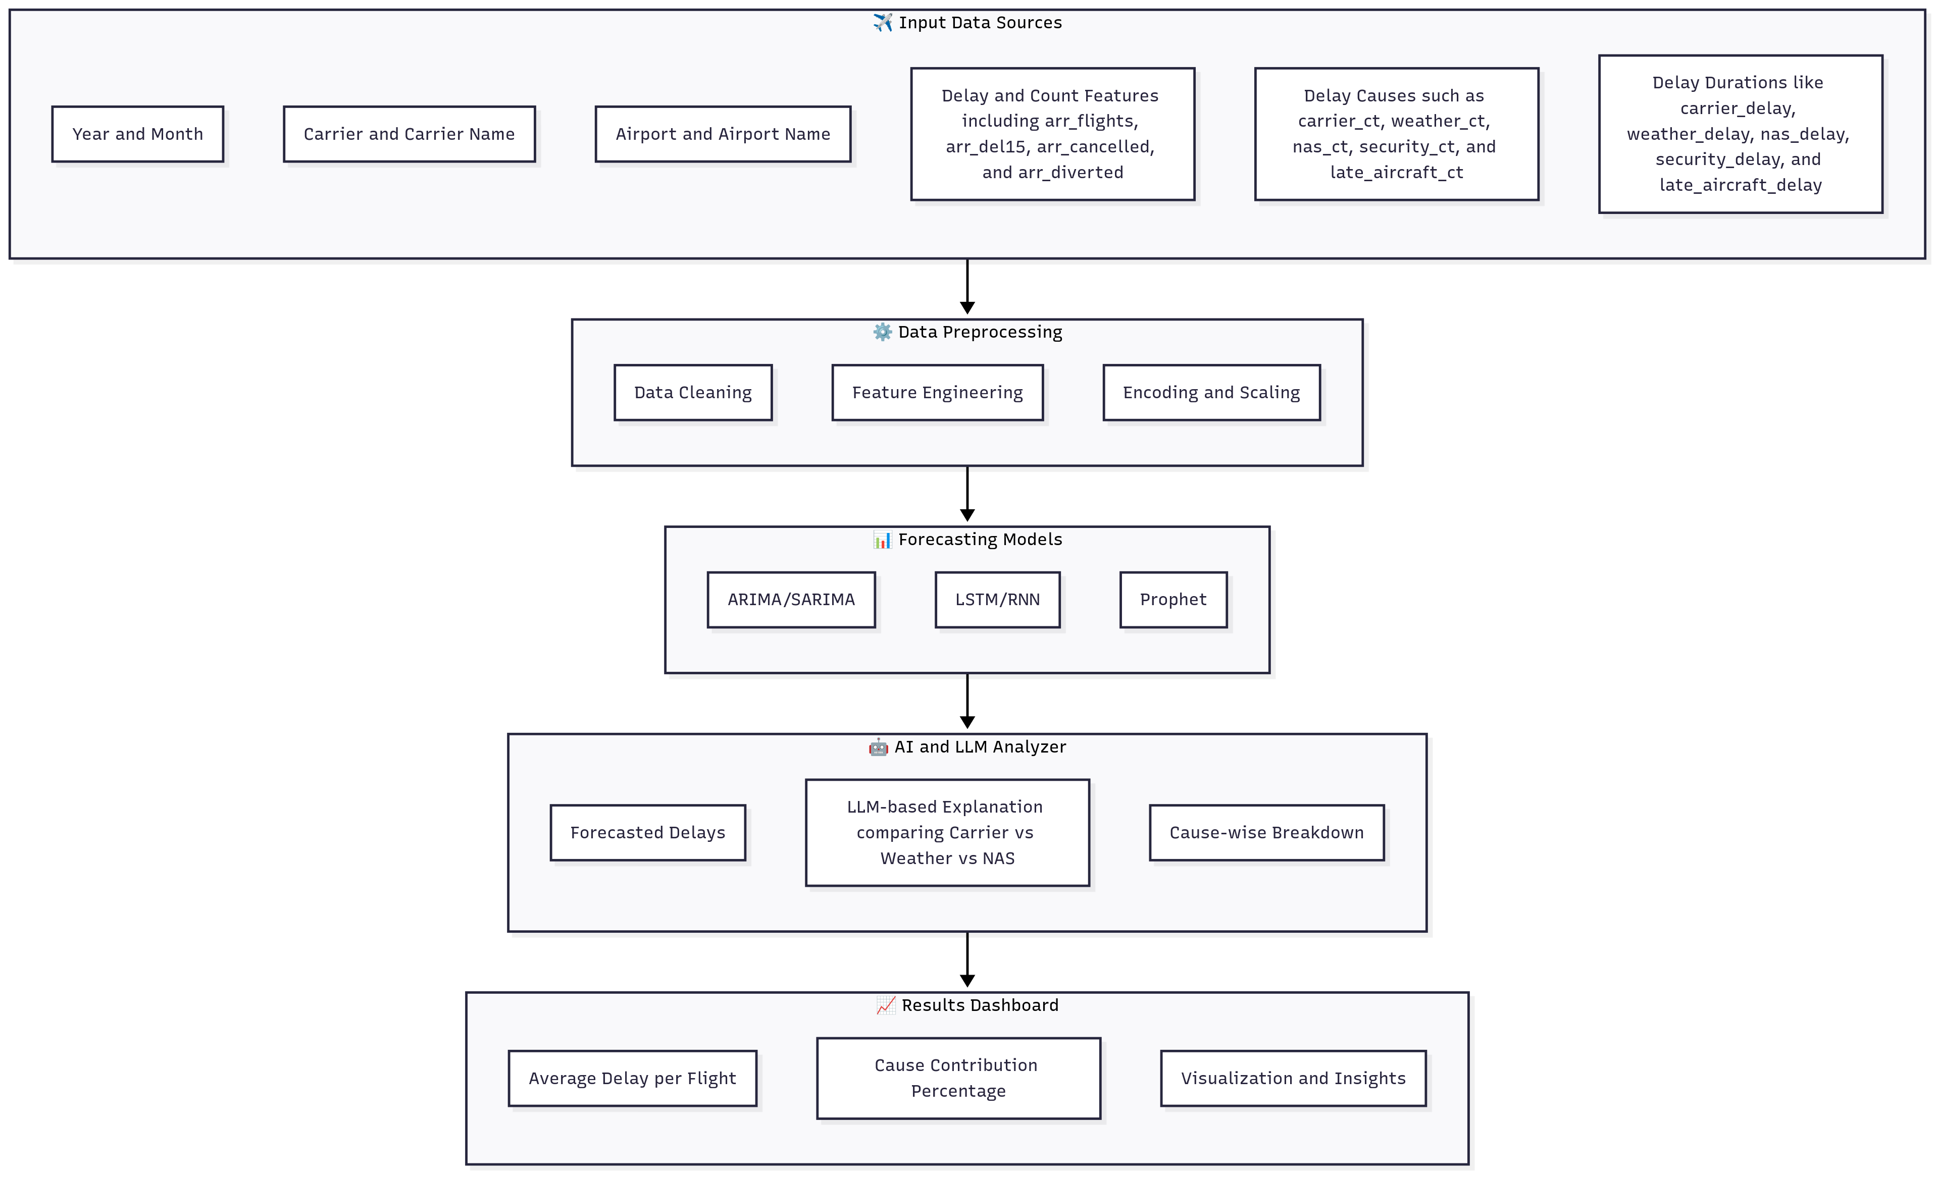
Architecture Diagram : AI-powered Flight Delay Predictor & Analyzer

Slide 9
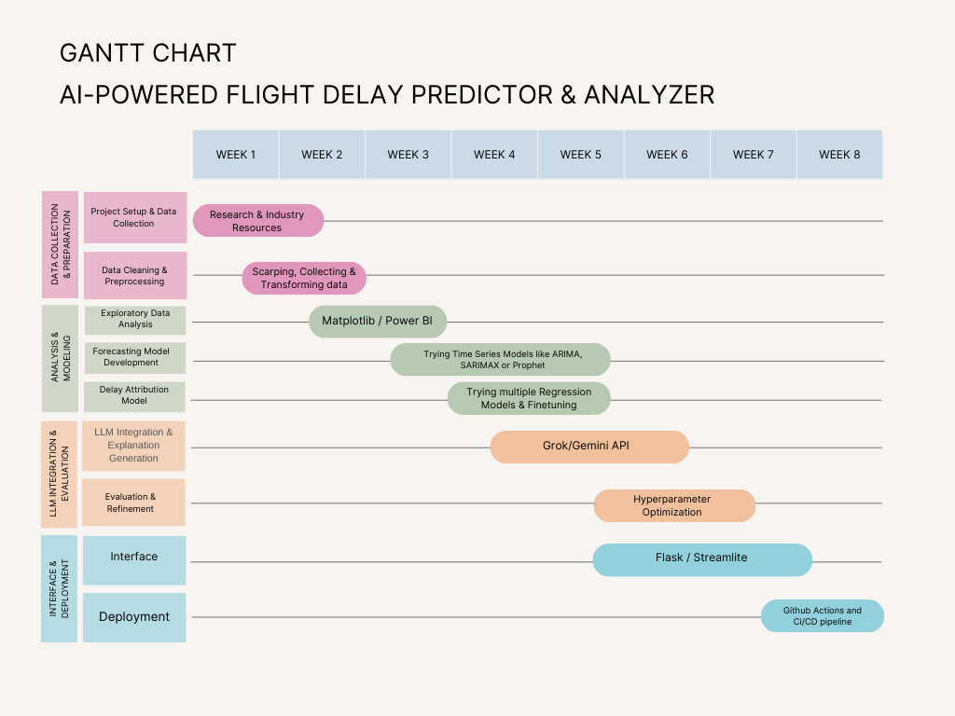
Gantt Chart:

Slide 10
Thank You

Slide 11
Project Title - Calibri body 18
Modules to cover…. Calibri body -36
Module 1 calibri 28

Slide 12
Project Title - Calibri body 18
Module name - Calibri body -36
Subtopic - Calibri body -28
Content Calibri body -28
Calibri body -28

